Slide 1
만성질환의 발병율 및 진료비 추이
4조 실버 박지인, 이연경, 이다혜

Slide 2
목차
THE PARTS
01
프로젝트 소개
02
이슈
03
아쉬운 점 & 소감
04
Q & A

Slide 3
프로젝트 소개
01

Slide 4

1. 프로젝트 소개
1) 선정 이유
질병 예방
진행 속도 완화
건강수명연장
의료비 절감
합병증 예방

Slide 5
1. 프로젝트 소개
2) 데이터 조사 대상 : 만성질환 3가지
대상질병
01
고혈압
Hypertension
치매
02
Dementia
03
당뇨
Diabetes mellitus

Slide 6
1. 프로젝트 소개
2) 데이터 조사 대상 : 범주
환자구분
입원 및 외래
Ward / OPD
대상연령
전 연령
All age
대상질병
고혈압/ 당뇨/ 치매
HBP / DM / Dementia
대상지역
시/도 지역별
All area

Slide 7


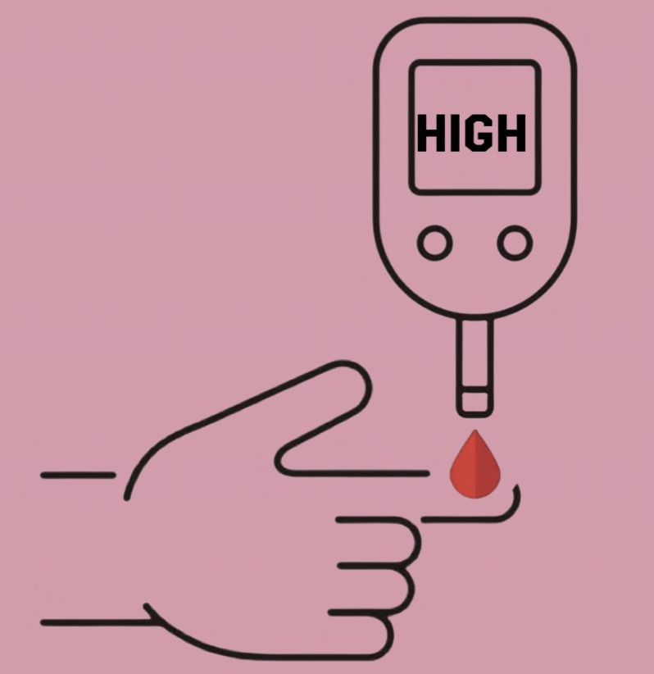
1. 프로젝트 소개
3) 질병 소개
고혈압 | 치매 | 당뇨
수축기혈압 140mmHg이상 또는 이완기혈압 90mmHg이상 | 뇌기능의 손상으로 인지기능이 저하되는 퇴행성 질환 | 혈액 속의 포도당이 체내에서 에너지로 사용되지 못하고 쌓여 소변으로 넘치는 질환

Slide 8
1. 프로젝트 소개
4) 샤이니 앱 실제 구현

Slide 9
이슈
02

Slide 10
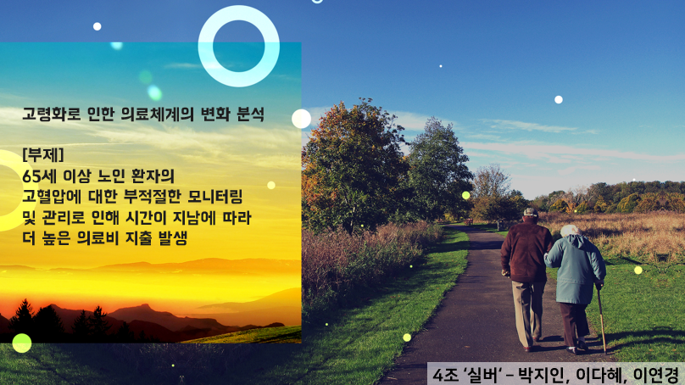
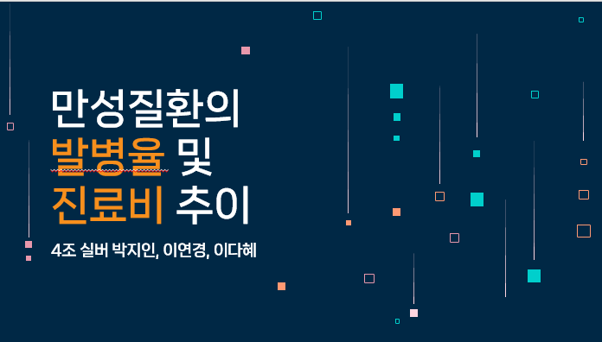
2. 이슈
1) 초기 계획과 달라진 점들
* 주제 변경
고령화로 인한 의료체계의 변화 분석
만성질환의 발병율 및 진료비 추이

Slide 11
2. 이슈
2) 개발 도중 있었던 에러들 (어떻게 해결했는지)

Slide 12
2. 이슈
3) 핵심 로직 깨달은 점

Slide 13
아쉬운 점 & 소감
03

Slide 14
3. 아쉬운 점 & 소감
1) 아쉬운 점

Slide 15
3. 아쉬운 점 & 소감
2) 소감

Slide 16
Q & A
04

Slide 17
ABOUT DATA SCIENCE CONSULTING INFOGRAPHICS
소감
01
박지인
Venus is the second planet from the Sun
02
이다혜
03
이연경
Earth is the third planet from the Sun

Slide 18
ABOUT DATA SCIENCE CONSULTING INFOGRAPHICS
Q & A

Slide 19
ABOUT DATA SCIENCE CONSULTING INFOGRAPHICS
YEARLY PLANNING
 | Write your own text | JUL | Write down your own text
FEB | Write down your own text | AGO | Write down your own text
MAR | Write down your own text | SEP | Write down your own text
APR | Write down your own text | OCT | Write down your own text
MAY | Write down your own text | NOV | Write down your own text
JUN | Write down your own text | DEC | Write down your own text

Slide 20
ABOUT DATA SCIENCE CONSULTING INFOGRAPHICS
01
02
03
DATA A
DATA B
DATA C
Despite being red, Mars is very cold
Earth is also known as the Blue Planet
Jupiter was named after a Roman god

Slide 21
ABOUT DATA SCIENCE CONSULTING INFOGRAPHICS
30%
JUPITER
Jupiter is the biggest planet of them all
60%
SATURN
Saturn is not the only planet with rings
90%
MARS
Despite being red, Mars is very cold

Slide 22
ABOUT DATA SCIENCE CONSULTING INFOGRAPHICS
SUCCESS ROAD
Venus is the second planet from the Sun
Jupiter is the biggest planet of them all
STEP 2
STEP 4
STEP 1
STEP 3
STEP 5
Despite being red, Mars is very cold
Earth is the third planet from the Sun
Saturn was named after a Roman god

Slide 23
ABOUT DATA SCIENCE CONSULTING INFOGRAPHICS
OUR NUMBERS
60%
90%
70%
30%
MARS
VENUS
JUPITER
EARTH
Despite being red, Mars is very cold
Venus is the second planet from the Sun
Jupiter is the biggest planet of them all
Earth is the third planet from the Sun

Slide 24
ABOUT DATA SCIENCE CONSULTING INFOGRAPHICS
OUR VALUES
JUPITER
SATURN
NEPTUNE
Jupiter is the biggest planet of them all
Saturn is a gas giant and has several rings
Neptune is very far away from the Sun

Slide 25
ABOUT DATA SCIENCE CONSULTING INFOGRAPHICS
WE STAND OUT
THEM
US
Earth is the planet with life
60%
100%
Mars is full of iron oxide dust
Jupiter is a huge gas giant
40%
80%
Saturn is the ringed planet
Neptune is far away from us
20%
60%
Mercury is a small planet

Slide 26
ABOUT DATA SCIENCE CONSULTING INFOGRAPHICS
REVENUE FOR LAST YEAR
$10,000,000
JANUARY
APRIL
$9,000,000
Mercury is the closest planet to the Sun
Venus is the second planet from the Sun
$8,000,000
AUGUST
DECEMBER
$5,000,000
Earth is the planet where we all live
Saturn is a gas giant and has several rings

Slide 27
ABOUT DATA SCIENCE CONSULTING INFOGRAPHICS
Saturn is the ringed planet
Mercury is a small planet
SATURN
MERCURY
JUPITER
NEPTUNE
Jupiter is the biggest planet
Neptune is far away from us

Slide 28
ABOUT DATA SCIENCE CONSULTING INFOGRAPHICS
50%
MERCURY
Mercury is the closest planet to the Sun
25%
JUPITER
Jupiter is the biggest planet of them all
35%
MARS
Despite being red, Mars is very cold

Slide 29
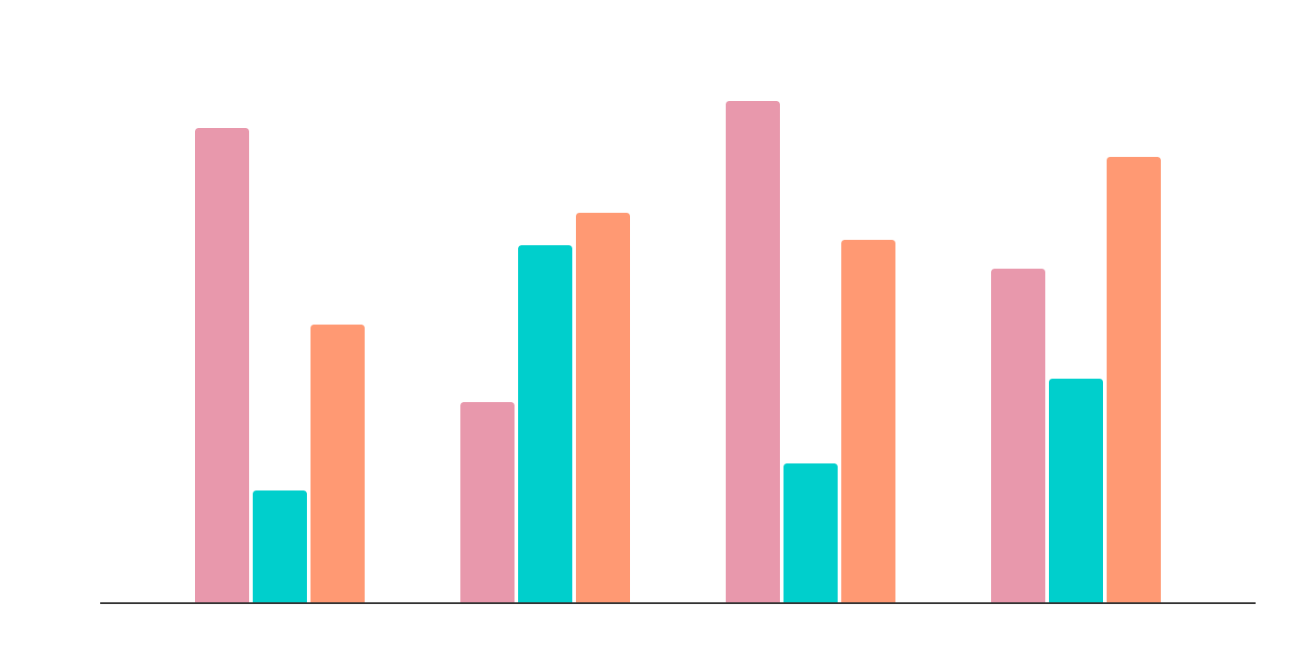
ABOUT DATA SCIENCE CONSULTING INFOGRAPHICS
INCOME
Saturn is the ringed planet
COST
Mars is full of iron oxide dust
PROFITS
Jupiter is the biggest planet
Follow the link in the graph to modify its data and then paste the new one here. For more info, click here

Slide 30
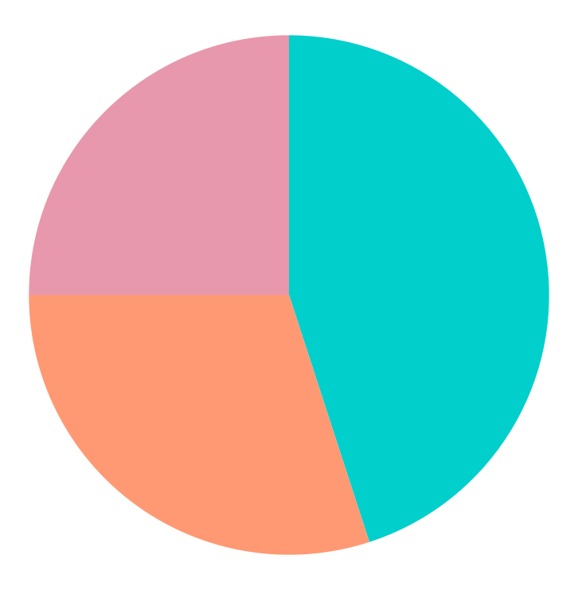
ABOUT DATA SCIENCE CONSULTING INFOGRAPHICS
45%
MALE
Venus is hot
30%
FEMALE
SATURN
NEPTUNE
25%
OTHER
Mars is cold
Saturn is the ringed planet
Neptune is an ice giant
Jupiter is big
Follow the link in the graph to modify its data and then paste the new one here. For more info, click here

Slide 31
ABOUT DATA SCIENCE CONSULTING INFOGRAPHICS
ANNUAL TASKS
TASK 1
TASK 2
TASK 3
Venus is hot
Earth has life
Mars is very cold
20XX | JAN-MAR | APR-JUN | JUL-SEP | OCT-DEC
TASK 1
TASK 2
TASK 3
Mercury is a very small planet
Venus is hot
Mars is cold

Slide 32
ABOUT DATA SCIENCE CONSULTING INFOGRAPHICS
NEW MARKETS
NEW PRODUCTS
Mercury is a small planet
Jupiter is the biggest planet
Venus has a toxic atmosphere
Saturn has beautiful rings
Earth is the planet with life
Neptune is far away from us
Mars was named after a god
Pluto is a dwarf planet

Slide 33
ABOUT DATA SCIENCE CONSULTING INFOGRAPHICS
MARS
Despite being red, Mars is very cold
EARTH
JUPITER
Earth is the third planet from the Sun and the only one that harbors life in the Solar System
Jupiter is the biggest planet of them all
SATURN
Saturn was named after a Roman god

Slide 34
ABOUT DATA SCIENCE CONSULTING INFOGRAPHICS
MARKET SIZE
10,000,000
100,000
1,000
VENUS
JUPITER
SATURN
Venus is the second planet from the Sun
Jupiter is the biggest planet of them all
Saturn is a gas giant and has several rings

Slide 35
ABOUT DATA SCIENCE CONSULTING INFOGRAPHICS
50%
Mercury is the closest planet to the Sun
30%
Venus is the second planet from the Sun
10%
Earth is the third planet from the Sun
10%
Jupiter is the biggest planet of them all

Slide 36

ABOUT DATA SCIENCE CONSULTING INFOGRAPHICS
85%
MANAGEMENT
Mercury is very small
60%
ANALYTICS
Mars is very cold
70%
BUSINESS
Venus is very hot
Follow the link in the graph to modify its data and then paste the new one here. For more info, click here

Slide 37
ABOUT DATA SCIENCE CONSULTING INFOGRAPHICS
NEPTUNE
50%
70%
40%
JUPITER
MERCURY
SATURN
Jupiter is the biggest planet of them all
Mercury is the closest planet to the Sun
Saturn was named after a Roman god

Slide 38
ABOUT DATA SCIENCE CONSULTING INFOGRAPHICS
CHECKLIST
Add your task here | X
Add your task here
Add your task here
Add your task here
Add your task here | X
TASKS FOR TODAY
Venus is the second planet from the Sun
Despite being red, Mars is very cold
Saturn is not the only planet with rings

Slide 39
Instructions for use
If you have a free account, in order to use this template, you must credit Slidesgo in your final presentation. Please refer to the next slide to read the instructions for premium users.
As a Free user, you are allowed to:
- Modify this template.
- Use it for both personal and commercial projects.
You are not allowed to:
- Sublicense, sell or rent any of Slidesgo Content (or a modified version of Slidesgo Content).
- Distribute Slidesgo Content unless it has been expressly authorized by Slidesgo.
- Include Slidesgo Content in an online or offline database or file.
- Offer Slidesgo templates (or modified versions of Slidesgo templates) for download.
- Acquire the copyright of Slidesgo Content.
For more information about editing slides, please read our FAQs or visit our blog:
https://slidesgo.com/faqs and https://slidesgo.com/slidesgo-school

Slide 40
Instructions for use (premium users)
As a Premium user, you can use this template without attributing Slidesgo.
You are allowed to:
Modify this template.
Use it for both personal and commercial purposes.
Share this template in an editable format with people who are not part of your team.
You are not allowed to:
Sublicense, sell or rent this Slidesgo Template (or a modified version of this Slidesgo Template).
Distribute this Slidesgo Template (or a modified version of this Slidesgo Template) or include it in a database or in any other product or service that offers downloadable images, icons or presentations that may be subject to distribution or resale.
Use any of the elements that are part of this Slidesgo Template in an isolated and separated way from this Template.
Register any of the elements that are part of this template as a trademark or logo, or register it as a work in an intellectual property registry or similar.
For more information about editing slides, please read our FAQs or visit our blog:
https://slidesgo.com/faqs and https://slidesgo.com/slidesgo-school

Slide 41
Infographics
You can add and edit some infographics to your presentation to present your data in a visual way.
Choose your favourite infographic and insert it in your presentation using Ctrl C + Ctrl V or Cmd C + Cmd V in Mac.
Select one of the parts and ungroup it by right-clicking and choosing “Ungroup”.
Change the color by clicking on the paint bucket.
Then resize the element by clicking and dragging one of the square-shaped points of its bounding box (the cursor should look like a double-headed arrow). Remember to hold Shift while dragging to keep the proportions.
Group the elements again by selecting them, right-clicking and choosing “Group”.
Repeat the steps above with the other parts and when you’re done editing, copy the end result and paste it into your presentation.
Remember to choose the “Keep source formatting” option so that it keeps the design. For more info, please visit our blog.

